Slide 1
Introduction to disaster management Dr. Doss Prakash Dept. OF community physiotherapy MGM institute of physiotherapy CHH. SAMBHAJINAGAR

Slide 2
Disclaimer
VID_64350319_115005_257.mp4

Slide 7
26th December 2004

Slide 8
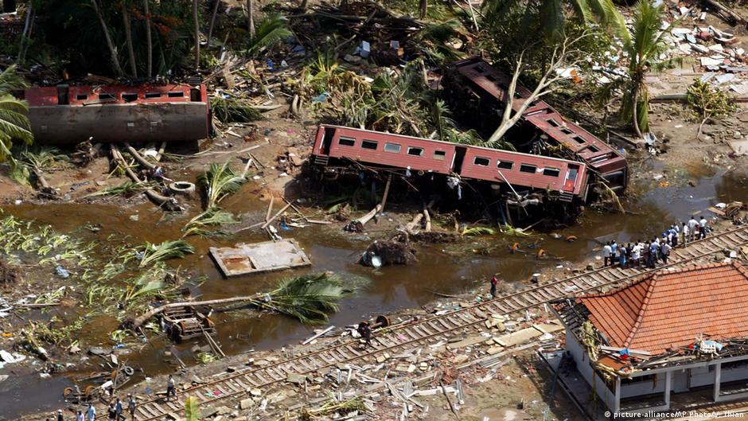

Slide 11
DEFINITIONS

Slide 12
DEFINITION OF HAZARD

Slide 13
Classification of Disasters

Slide 14
Natural Diasters
Indian Ocean & south pacific – Cyclone, North East pacific – Hurricane, & Asia - Typhoon

Slide 15
Man made disasters

Slide 16
DISASTER MANAGEMENT

Slide 22
1. Disaster Preparedness

Slide 23
Co-ordination of a variety of sectors to carry out-
Evaluation of the risk.
Adopt standards and regulations.
Organize communication and response mechanism.
Ensure all resources- ready and easily mobilized.
Develop public education programmes.
Coordinate information with news media.
Disaster simulation exercises.

Slide 24
Medical Preparedness & Mass Casualty Management
Developing and capacity building of medical team for
Trauma & psycho-social care,
Mass casualty management and Triage.
Determine casualty handling capacity of all hospitals.
Formulate appropriate treatment procedures.
Involvement of private hospitals.
Identify structural integrity and approach routes.

Slide 25
2. Disaster Impact

Slide 26
3. Disaster Response

Slide 36
4.

Slide 37
5.

Slide 56
THANK YOU

